Slide 1
RELIEF HOTEL WEBSITE

Slide 2
HOME PAGE

Slide 3
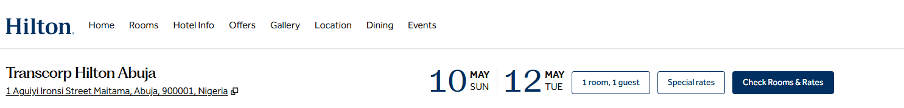


Sample Heading
Actual Heading
RELIEF HOTELS & SUITES
LOCATION
Home Rooms Dining Events and meetings Gallery Experience
2 CICC Road, Ikot Mbo, Calabar, Cross River, Nigeria
Web reference: Abuja Hotels - Transcorp Hilton Abuja - Hotels in Abuja, Nigeria

Slide 4
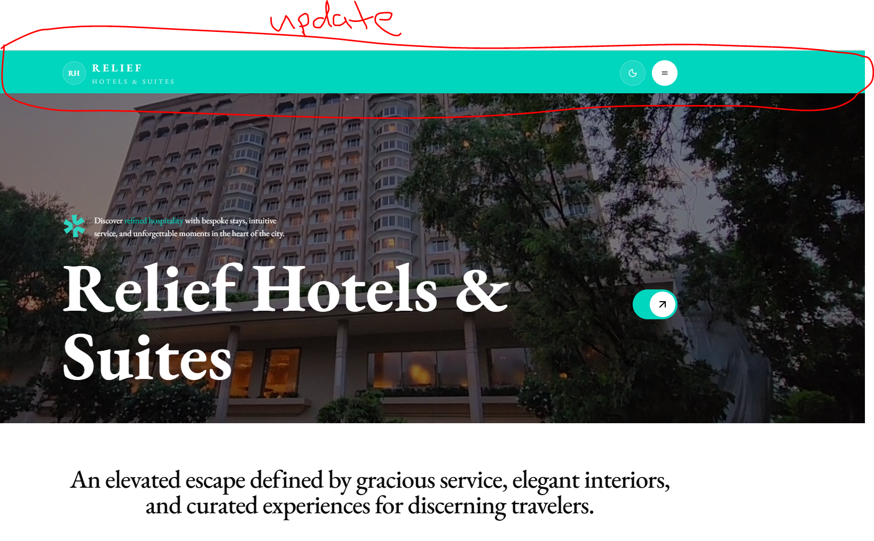
UPGRADE HEADING

Slide 5
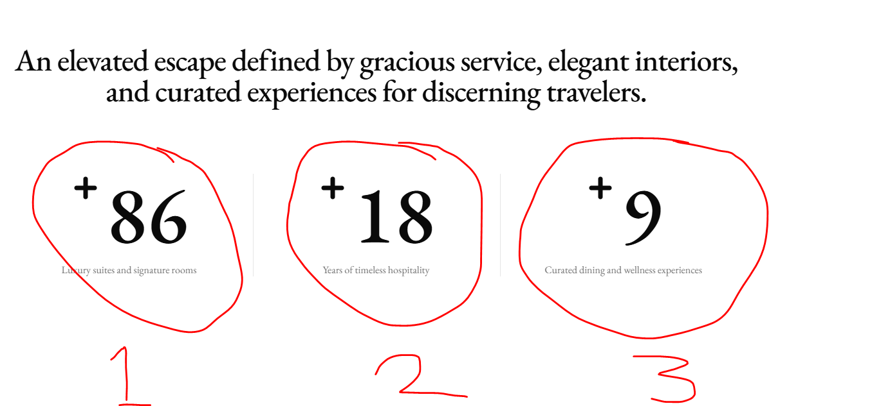
CHANGE ABOVE TO
+24 Luxury Suites and penthouse
+150 indoor and outdoor seating
+3 VIP bar, Private lodge and restaurant

Slide 6
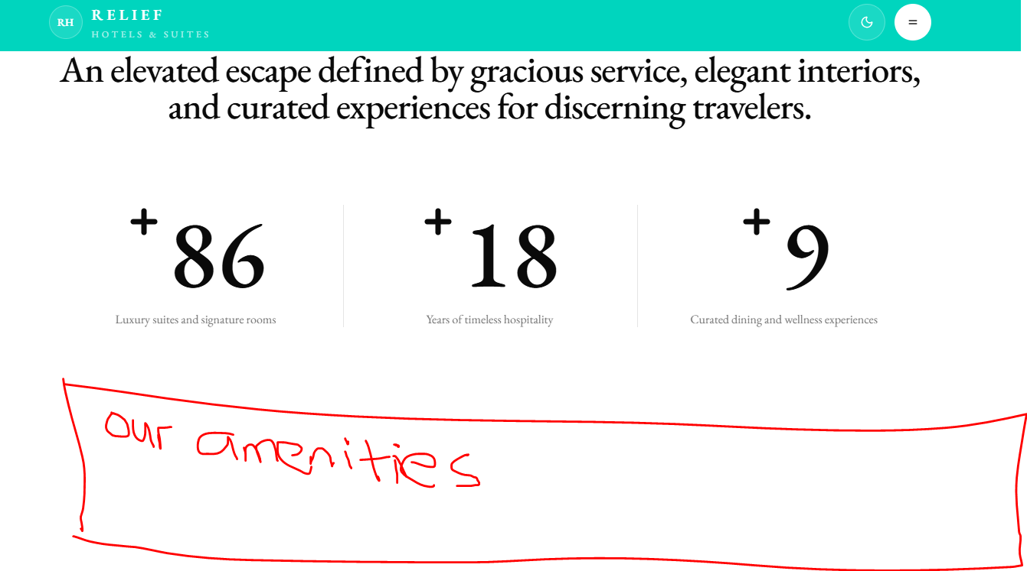

Slide 7
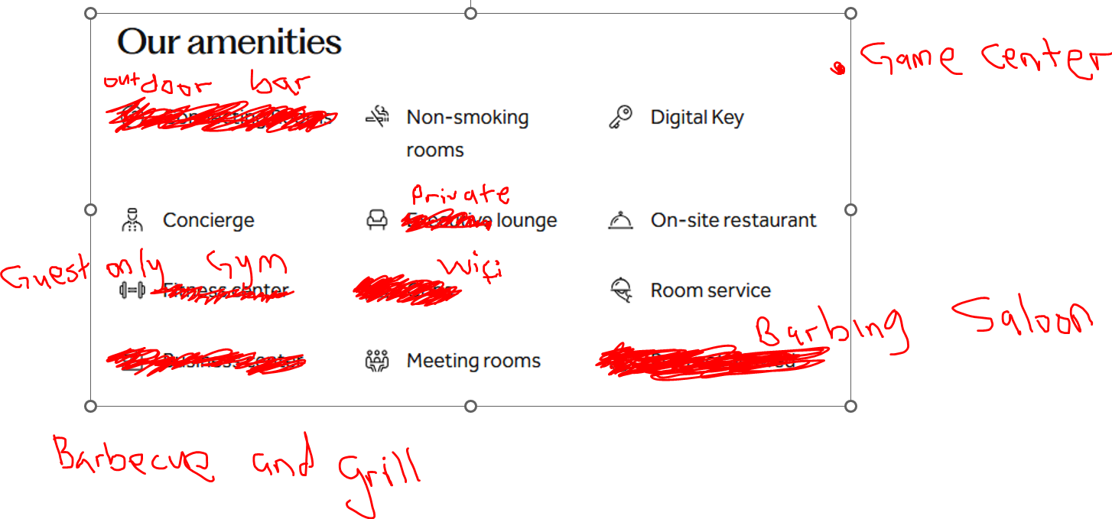

Slide 8

NOTE
Keep this, looks good
LOCATION
Drop down menu listing the locations where the hotel is location e.g- Calabar, Abuja etc. Use only Calabar for now

Slide 9
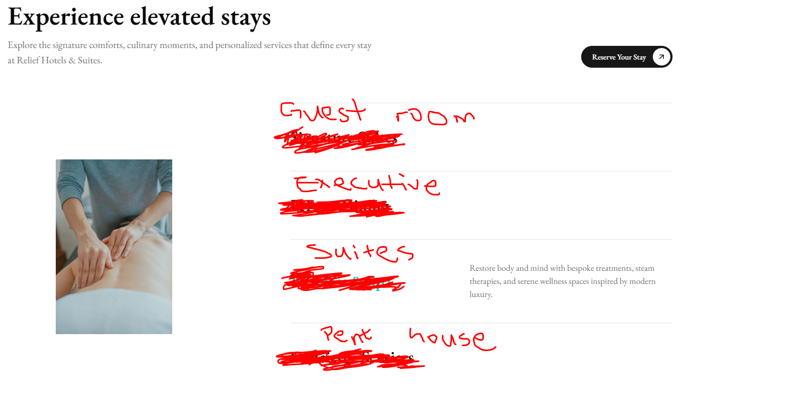

Slide 10
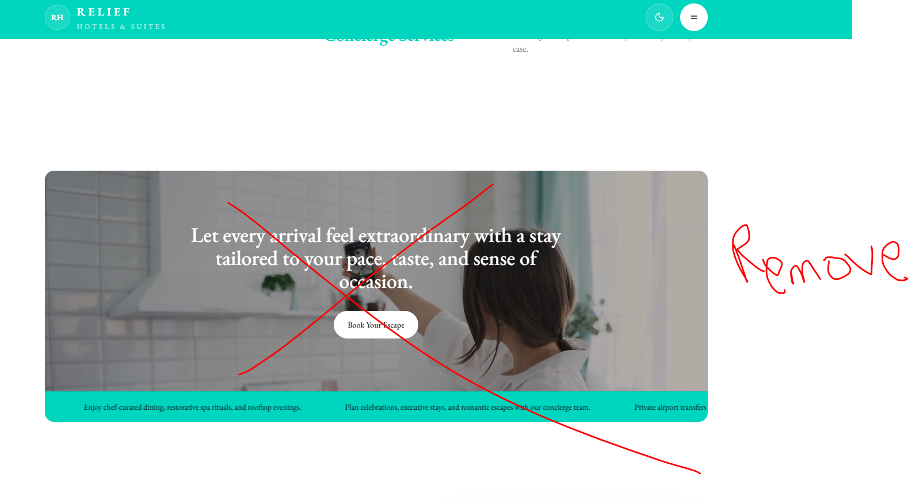

Slide 11
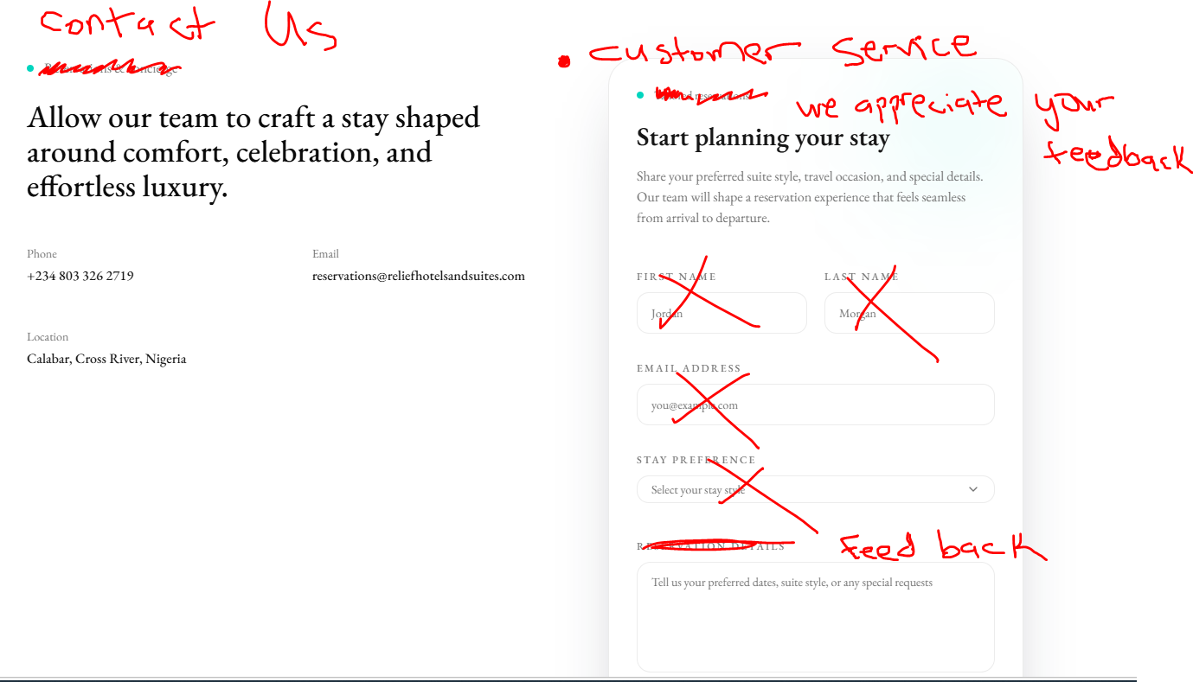

Slide 12
ROOMS TAB

Slide 13
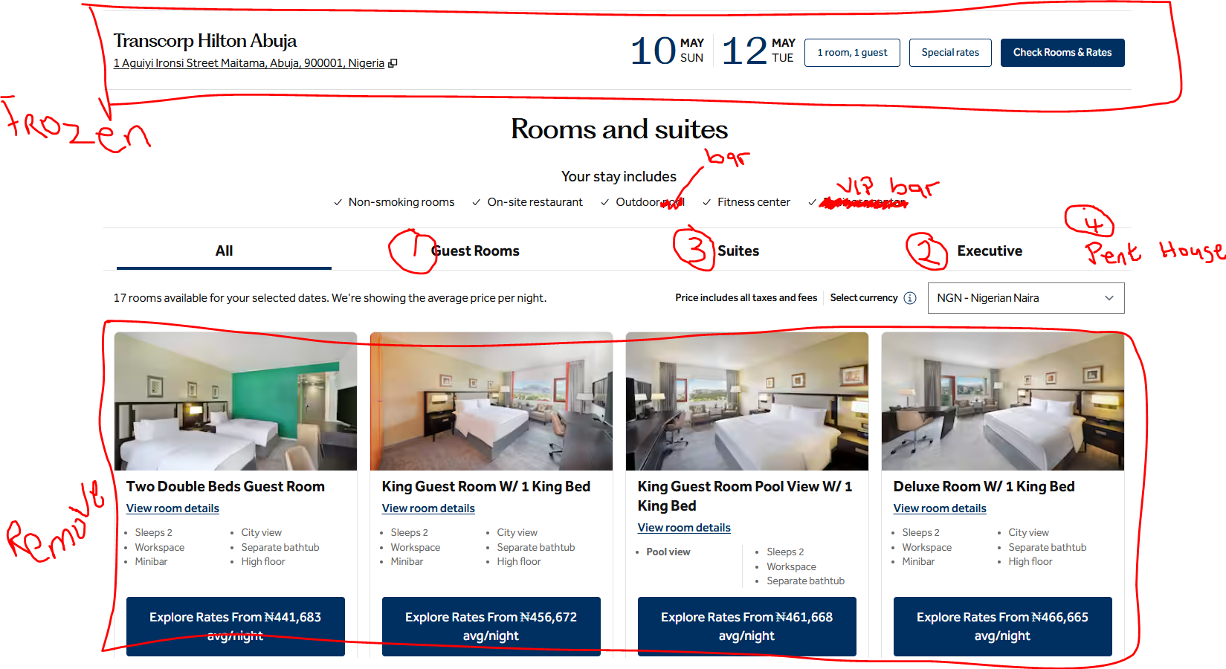
Web reference: Abuja Hotels - Transcorp Hilton Abuja Hotel - Abuja Accommodations

Slide 14
NOTE
Rearrange the rooms in this order:
All – Guest House – Executive – Suites – Pent house

Slide 15
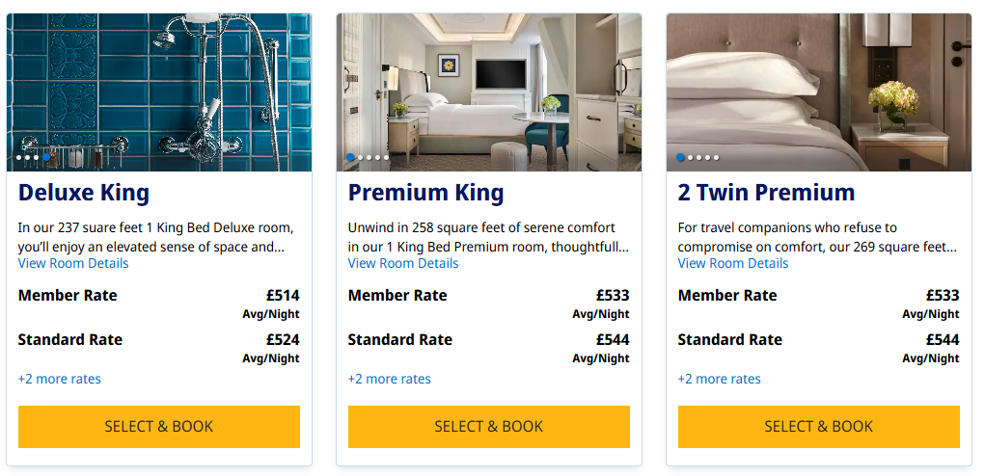
REPLACE ROOM PICTURES WITH BELOW
3 PER ROW, AND CAN FLIP BETWEEN ROOM PICTURES
Web reference: Hyatt | Select Room

Slide 16
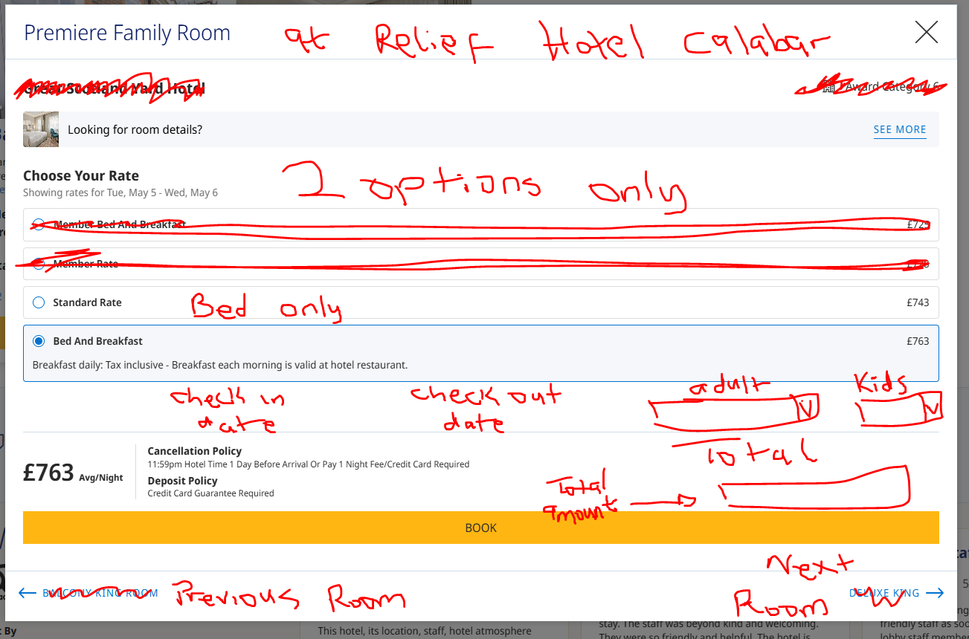
When you click on a room, a page like this comes up
Web reference: Hyatt | Select Room

Slide 17
GALLERY TAB

Slide 18
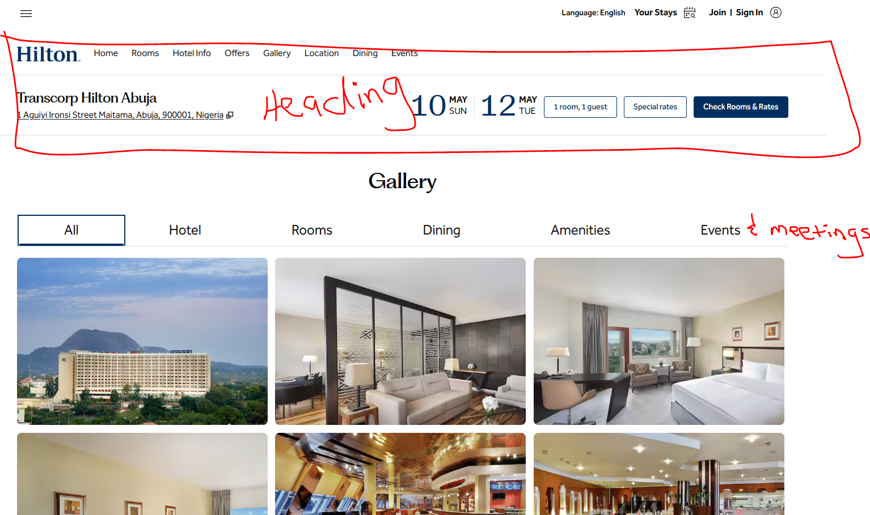
Web reference: Transcorp Hilton Abuja Photo Gallery

Slide 19
EVENTS AND MEETINGS TAB

Slide 20
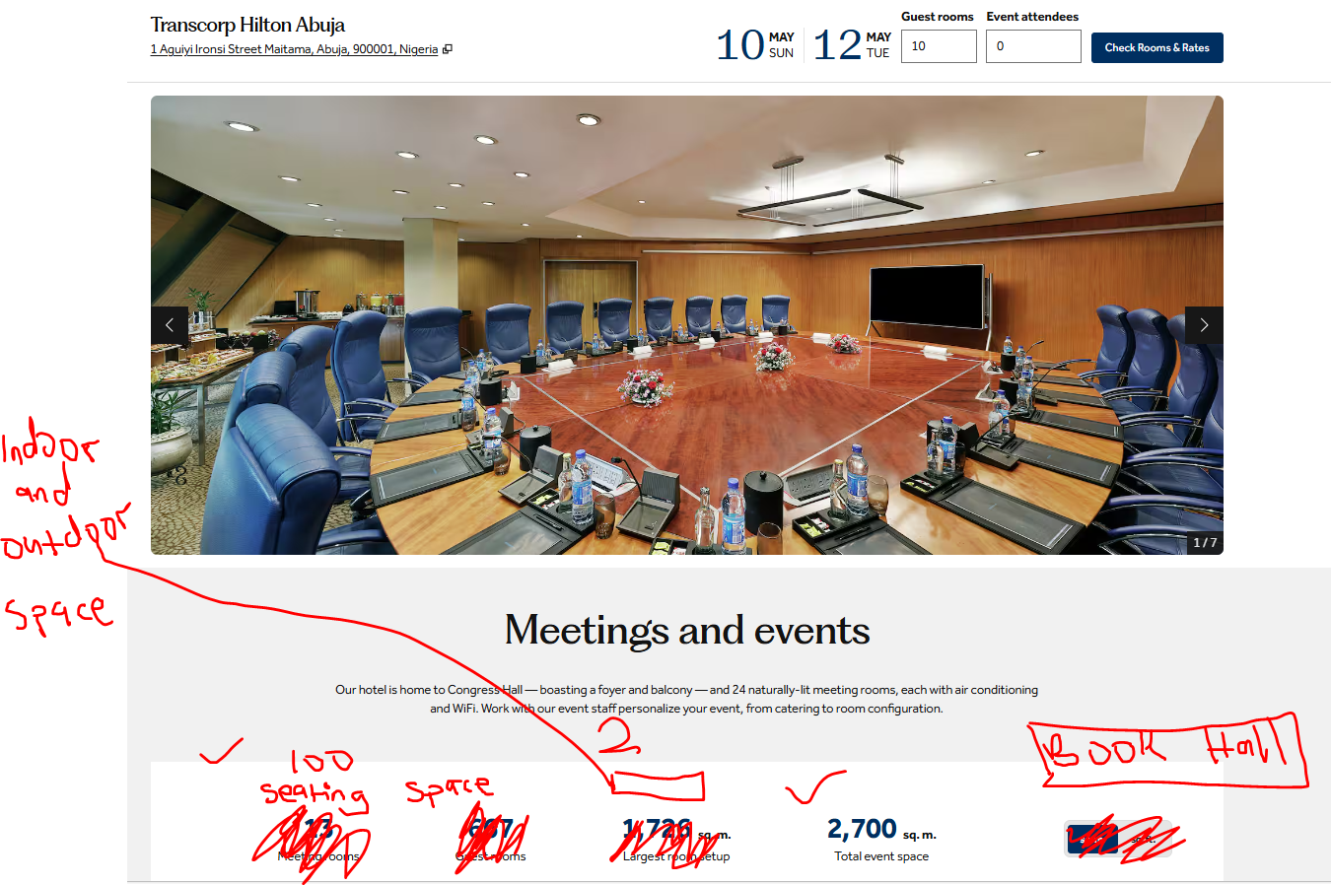
Web reference: Conference Hotels in Abuja - Transcorp Hilton Abuja Hotel - Abuja

Slide 21
DINING TAB

Slide 22
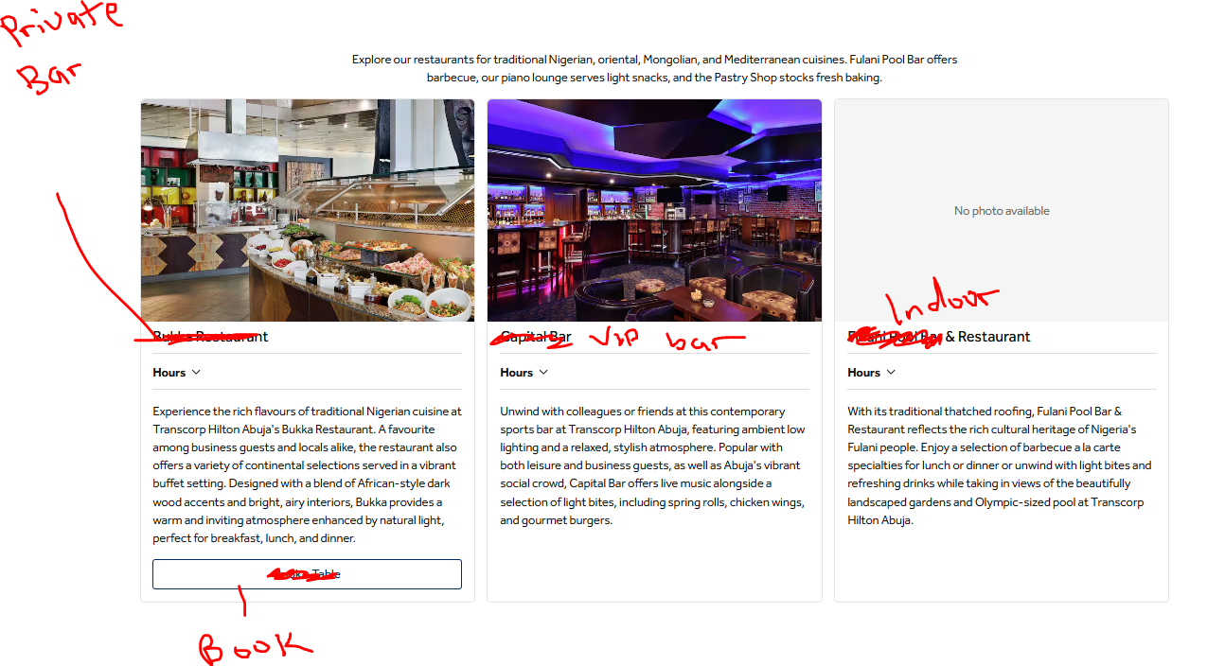
Web reference: Abuja Hotels and Restaurants - Transcorp Hilton Abuja Hotel - Abuja

Slide 23
EXPERIENCE TAB

Slide 24
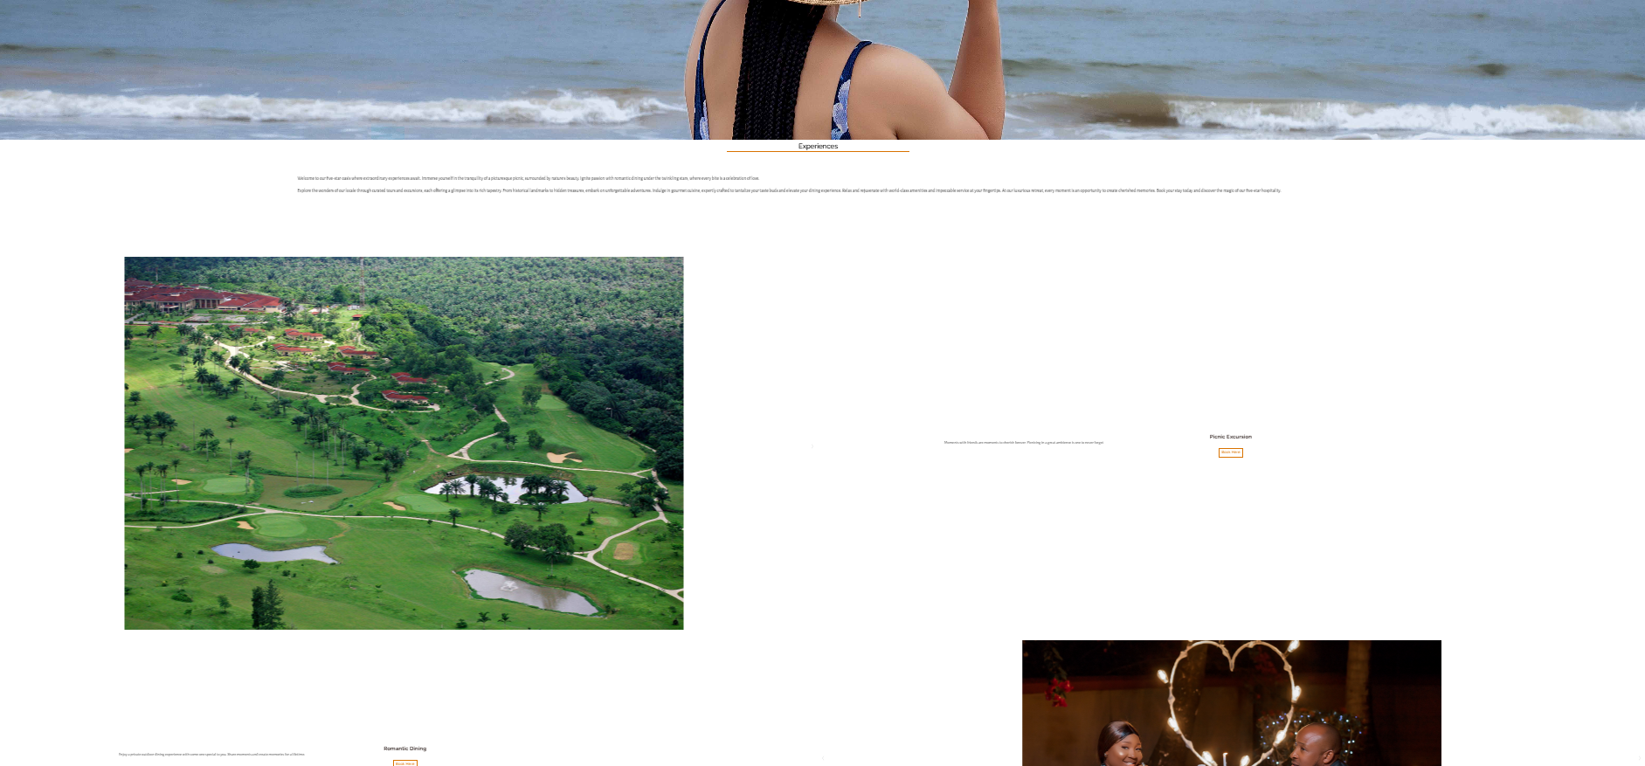
Web reference: Experience - Ibom Hotel & Golf Resort

Slide 25
List top 20 places for hotel guests to visit in Calabar, attach pictures and links to the places if possible.

